Slide 1
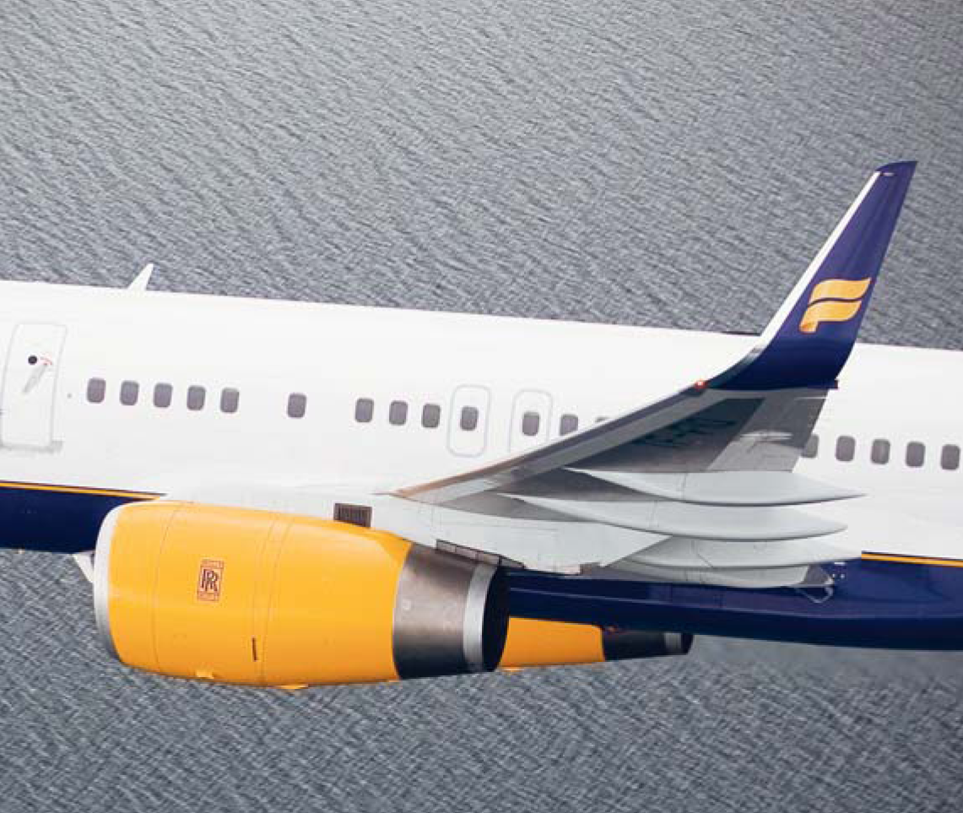
Press Release | Monthly Traffic Performance Data | February 2010 Icelandair Group Traffic Data Based on figures for the month of February 2010

Slide 2
Icelandair Group – focus on Icelandair
Key Markets Status:
Number of passengers in February increased by 18%. RPK increased by 24%.
All markets: To Iceland, From Iceland and VIA Iceland grew. Sales especially good on the TO market from US and UK. All VIA markets with major growth.
Feb
2010
Feb
2009
Operations in February:
Total capacity increase year-on-year was 27%. US capacity increased by 44% and has not been as high since 2006. Meanwhile capacity by other European airlines on the N-Atlantic in February is down by 2% total.
Load factor was 66,5%, 1,6% lower than in February 2009
Next traffic data for Icelandair Group will be released on April 9th 2010
For further information please contact Bogi Nils Bogason – CFO of Icelandair Group
Reykjavík Airport | 101 Reykjavík Iceland | Tel: +354 50 50 300 | Fax: +354 50 50 389

