Slide 1
Financial results for the Q3 and 9 months of 2008 October 2008

Slide 2
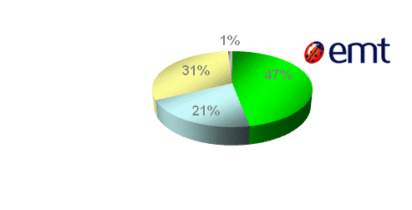
EMT’s market position
 | Sept 2008 | Sept 2007 | +/-
Mobile data users (in th.) | 153,0 | 119,0 | 34,0
EMT’s estimated market share (by number of active SIM-cards) was 47%

Slide 3
Elion’s market position
80,4% of call minutes initiated from fixed networks
 | Sept 2008 | Sept 2007 | +/-
Total means of communication (in th.) | 471,3 | 470,2 | 1,1
No of permanent Internet connections (in th.) | 172,0 | 157,0 | 15,0
No of IP and cable-TV customers (in th.) | 75,4 | 48,4 | 27,0

Slide 4
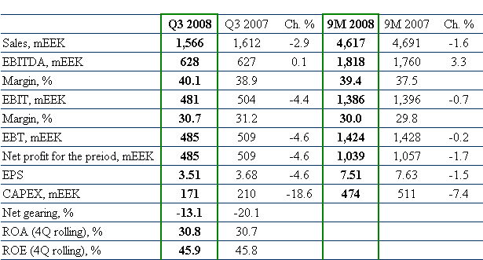
Financial results Eesti Telekom Group

Slide 5
Dynamics of sales
Sales revenues were primarily affected by the reduction in mobile interconnection fees;
Continued growth in the number of permanent Internet connections and the users of triple packages and mobile data users

Slide 6
ARPU

Slide 7
Dynamics of OPEX
Decrease of mobile interconnect prices;
Increased volume of international call services

Slide 8
Dynamics of EBITDA

Slide 9
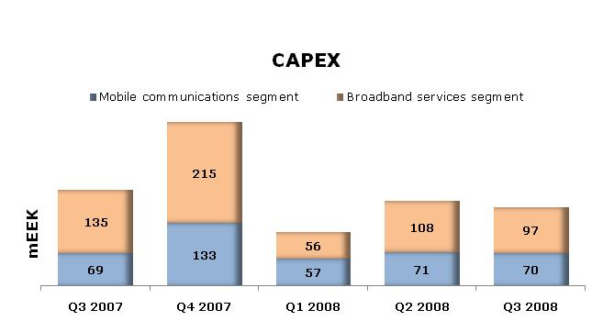
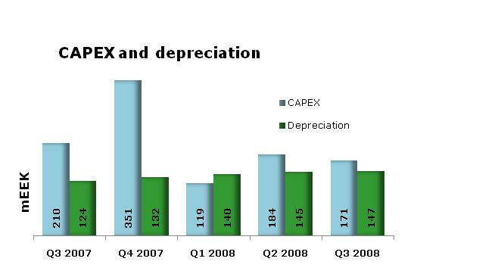
CAPEX and depreciation
Investing priorities:
Broadband
Internet and DigiTV access;
Mobile
Implementation of technologies supporting high-speed data communications;
IT
Expansion of the infrastructure necessary for the provision of services

Slide 10
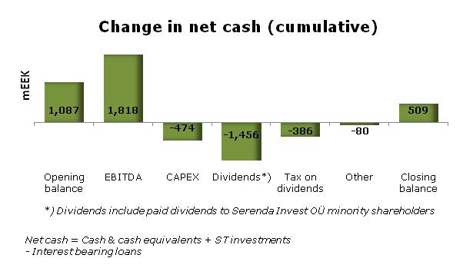
Cash position
Eesti Telekom Group paid record high dividends on 17 June 2008: 10.50 EEK per share;
In total, 1,449 mln EEK was paid out.

Slide 11
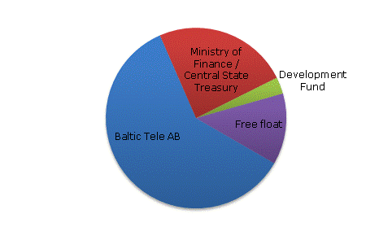
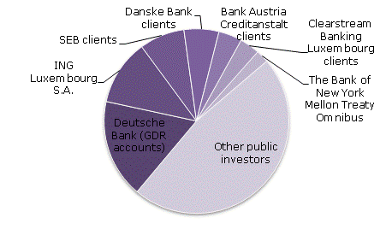
Largest shareholders of AS Eesti Telekom
 | 30 September 2008 |  | Change since 03 July 2008
 | No of shares | Participation
Baltic Tele AB | 82,936,299 | 60.1186% | 0
Ministry of Finance / Central State Treasury | 33,346,464 | 24.1721% | 0
Development Fund | 4,138,636 | 3.0000% | 0
Deutsche Bank (GDR accounts) | 3,031,797 | 2.1977% | -287,640
ING Luxembourg S.A. | 2,015,783 | 1.4612% | +197,453
SEB clients | 1,387,709 | 1.0059% | +57,859
Danske Bank clients | 1,070,739 | 0.7762% | -300,000
Bank Austria Creditanstalt clients | 721,370 | 0.5229% | -189,256
Clearstream Banking Luxembourg clients | 611,836 | 0.4435% | +31,500
The Bank of New York Mellon Treaty Omnibus | 392,152 | 0.2843% | 0

Slide 12
Trading statistics in Tallinn
SHARE INFORMATION
Veerg1 | 2003 | 2004 | 2005 | 2006 | 2007
Year-end number of shares | 137,644,428 | 137,954,528 | 137,954,528 | 137,954,528 | 137,954,528
Annual average number of shares | 137,535,574 | 137,825,320 | 137,954,528 | 137,954,528 | 137,954,528
Equity per share, EEK | 30.04 | 29.40 | 29.28 | 29.78 | 31.19
Earnings per share, EEK | 7.59 | 7.16 | 7.88 | 9.49 | 10.91
P/E ratio | 13.6 | 15.7 | 15.1 | 13.8 | 11.2
Dividends per share for the year, EEK | 8.00 | 8.00 | 9.00 | 9.50 | 10.50
Dividend payout ratio, % | 105.4 | 111.7 | 114.2 | 100.1 | 96.2
AS Eesti Telekom has been listed on the Tallinn and London Stock Exchanges (OMX:ETLAT/LSE:EETD) since 1999.

Slide 13
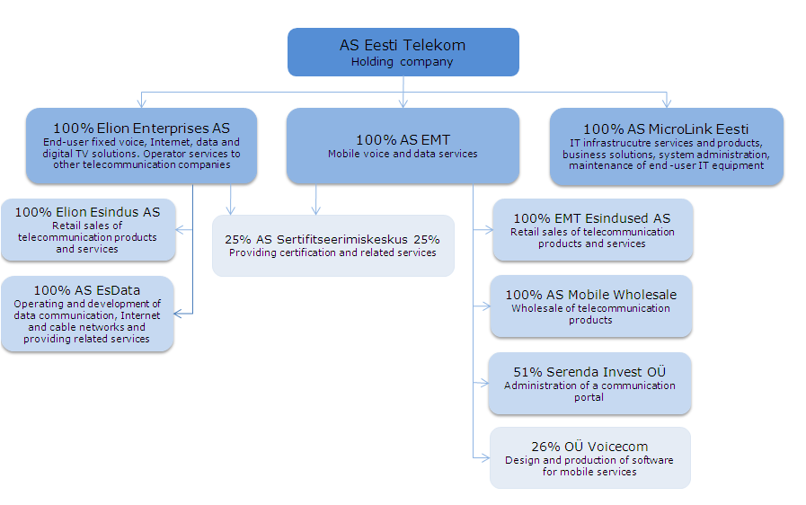
Structure of the Group

